Slide 1


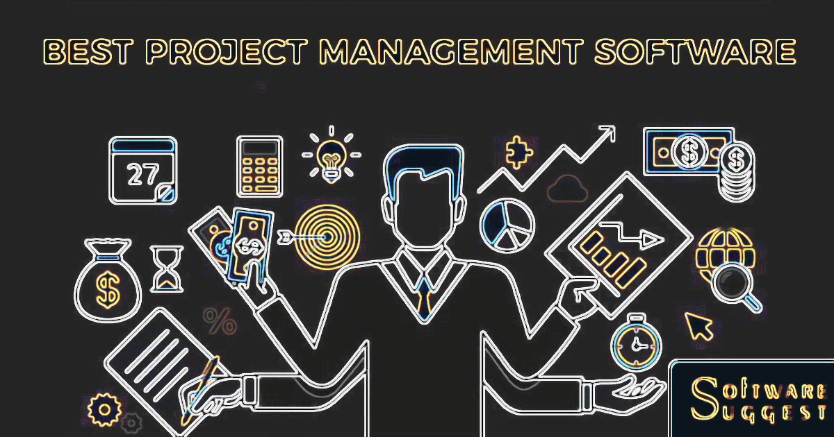
Software Engineering
WEEK 10
ENGR. Muhammad UMER HAROON

Slide 2

WEEK 10

Slide 3

Ninth Week Summary
Here is what we learned

Slide 4
Week 10– Project Management

Slide 5
Software project management
Concerned with activities involved in ensuring that software is delivered on time and on schedule and in accordance with the requirements of the organisations developing and procuring the software.
Project management is needed because software development is always subject to budget and schedule constraints that are set by the organisation developing the software.

Slide 6
Success criteria
Deliver the software to the customer at the agreed time.
Keep overall costs within budget.
Deliver software that meets the customer’s expectations.
Maintain a coherent and well-functioning development team.

Slide 7
Software management distinctions
The product is intangible.
Software cannot be seen or touched. Software project managers cannot see progress by simply looking at the artefact that is being constructed.
Many software projects are 'one-off' projects.
Large software projects are usually different in some ways from previous projects. Even managers who have lots of previous experience may find it difficult to anticipate problems.
Software processes are variable and organization specific.
We still cannot reliably predict when a particular software process is likely to lead to development problems.

Slide 8
Factors influencing project management
Company size
Software customers
Software size
Software type
Organizational culture
Software development processes
These factors mean that project managers in different organizations may work in quite different ways.

Slide 9
Universal management activities
Project planning
Project managers are responsible for planning. estimating and scheduling project development and assigning people to tasks.
Covered in Chapter 23.
Risk management
Project managers assess the risks that may affect a project, monitor these risks and take action when problems arise.
People management
Project managers have to choose people for their team and establish ways of working that leads to effective team performance.

Slide 10
Management activities
Reporting
Project managers are usually responsible for reporting on the progress of a project to customers and to the managers of the company developing the software.
Proposal writing
The first stage in a software project may involve writing a proposal to win a contract to carry out an item of work. The proposal describes the objectives of the project and how it will be carried out.

Slide 11
Risk management

Slide 12
Risk management
Risk management is concerned with identifying risks and drawing up plans to minimise their effect on a project.
Software risk management is important because of the inherent uncertainties in software development.
These uncertainties stem from loosely defined requirements, requirements changes due to changes in customer needs, difficulties in estimating the time and resources required for software development, and differences in individual skills.
You have to anticipate risks, understand the impact of these risks on the project, the product and the business, and take steps to avoid these risks.

Slide 13
Risk classification
There are two dimensions of risk classification
The type of risk (technical, organizational, ..)
what is affected by the risk:
Project risks affect schedule or resources;
Product risks affect the quality or performance of the software being developed;
Business risks affect the organisation developing or procuring the software.

Slide 14
Examples of project, product, and business risks
Risk | Affects | Description
Staff turnover | Project | Experienced staff will leave the project before it is finished.
Management change | Project | There will be a change of organizational management with different priorities.
Hardware unavailability | Project | Hardware that is essential for the project will not be delivered on schedule.
Requirements change | Project and product | There will be a larger number of changes to the requirements than anticipated.
Specification delays | Project and product | Specifications of essential interfaces are not available on schedule.
Size underestimate | Project and product | The size of the system has been underestimated.
CASE tool underperformance | Product | CASE tools, which support the project, do not perform as anticipated.
Technology change | Business | The underlying technology on which the system is built is superseded by new technology.
Product competition | Business | A competitive product is marketed before the system is completed.

Slide 15
The risk management process
Risk identification
Identify project, product and business risks;
Risk analysis
Assess the likelihood and consequences of these risks;
Risk planning
Draw up plans to avoid or minimise the effects of the risk;
Risk monitoring
Monitor the risks throughout the project;

Slide 16
Risk identification
May be a team activities or based on the individual project manager’s experience.
A checklist of common risks may be used to identify risks in a project
Technology risks.
Organizational risks.
People risks.
Requirements risks.
Estimation risks.

Slide 17
Examples of different risk types
Risk type | Possible risks
Estimation | The time required to develop the software is underestimated. (12) The rate of defect repair is underestimated. (13) The size of the software is underestimated. (14)
Organizational | The organization is restructured so that different management are responsible for the project. (6) Organizational financial problems force reductions in the project budget. (7)
People | It is impossible to recruit staff with the skills required. (3) Key staff are ill and unavailable at critical times. (4) Required training for staff is not available. (5)
Requirements | Changes to requirements that require major design rework are proposed. (10) Customers fail to understand the impact of requirements changes. (11)
Technology | The database used in the system cannot process as many transactions per second as expected. (1) Reusable software components contain defects that mean they cannot be reused as planned. (2)
Tools | The code generated by software code generation tools is inefficient. (8) Software tools cannot work together in an integrated way. (9)

Slide 18
Risk analysis
Assess probability and seriousness of each risk.
Probability may be very low, low, moderate, high or very high.
Risk consequences might be catastrophic, serious, tolerable or insignificant.

Slide 19
Risk types and examples
Risk | Probability | Effects
Organizational financial problems force reductions in the project budget (7). | Low | Catastrophic
It is impossible to recruit staff with the skills required for the project (3). | High | Catastrophic
Key staff are ill at critical times in the project (4). | Moderate | Serious
Faults in reusable software components have to be repaired before these components are reused. (2). | Moderate | Serious
Changes to requirements that require major design rework are proposed (10). | Moderate | Serious
The organization is restructured so that different management are responsible for the project (6). | High | Serious
The database used in the system cannot process as many transactions per second as expected (1). | Moderate | Serious

Slide 20
Risk types and examples
Risk | Probability | Effects
The time required to develop the software is underestimated (12). | High | Serious
Software tools cannot be integrated (9). | High | Tolerable
Customers fail to understand the impact of requirements changes (11). | Moderate | Tolerable
Required training for staff is not available (5). | Moderate | Tolerable
The rate of defect repair is underestimated (13). | Moderate | Tolerable
The size of the software is underestimated (14). | High | Tolerable
Code generated by code generation tools is inefficient (8). | Moderate | Insignificant

Slide 21
Risk planning
Consider each risk and develop a strategy to manage that risk.
Avoidance strategies
The probability that the risk will arise is reduced;
Minimization strategies
The impact of the risk on the project or product will be reduced;
Contingency plans
If the risk arises, contingency plans are plans to deal with that risk;

Slide 22
What-if questions
What if several engineers are ill at the same time?
What if an economic downturn leads to budget cuts of 20% for the project?
What if the performance of open-source software is inadequate and the only expert on that open source software leaves?
What if the company that supplies and maintains software components goes out of business?
What if the customer fails to deliver the revised requirements as predicted?

Slide 23
Strategies to help manage risk
Risk | Strategy
Organizational financial problems | Prepare a briefing document for senior management showing how the project is making a very important contribution to the goals of the business and presenting reasons why cuts to the project budget would not be cost-effective.
Recruitment problems | Alert customer to potential difficulties and the possibility of delays; investigate buying-in components.
Staff illness | Reorganize team so that there is more overlap of work and people therefore understand each other’s jobs.
Defective components | Replace potentially defective components with bought-in components of known reliability.
Requirements changes | Derive traceability information to assess requirements change impact; maximize information hiding in the design.

Slide 24
Strategies to help manage risk
Risk | Strategy
Organizational restructuring | Prepare a briefing document for senior management showing how the project is making a very important contribution to the goals of the business.
Database performance | Investigate the possibility of buying a higher-performance database.
Underestimated development time | Investigate buying-in components; investigate use of a program generator.

Slide 25
Risk monitoring
Assess each identified risks regularly to decide whether or not it is becoming less or more probable.
Also assess whether the effects of the risk have changed.
Each key risk should be discussed at management progress meetings.

Slide 26
Risk indicators
Risk type | Potential indicators
Estimation | Failure to meet agreed schedule; failure to clear reported defects.
Organizational | Organizational gossip; lack of action by senior management.
People | Poor staff morale; poor relationships amongst team members; high staff turnover.
Requirements | Many requirements change requests; customer complaints.
Technology | Late delivery of hardware or support software; many reported technology problems.
Tools | Reluctance by team members to use tools; complaints about CASE tools; demands for higher-powered workstations.

Slide 27

Thank You!

